Slide 1
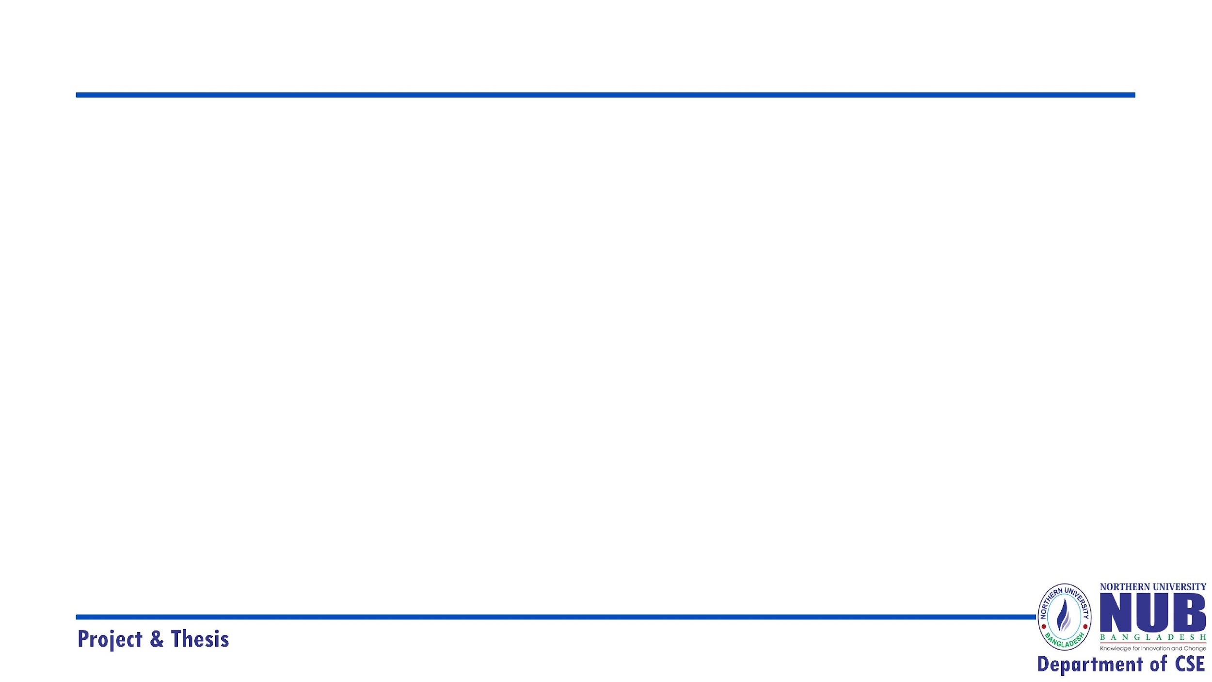
Explainable Mortality Prediction of Liver Cirrhosis Using Machine Learning Models
Northern University Bangladesh
Present by:
Sabus (41230101010)
Md. Ramin Hossain (41230100711)
Saifullah Mansur (41230100759)
Md. Nazmul Hassan ( 41230100695)
Supervised by
Simon Bin Akter
Lecturer
Department Of CSE
Northern University Bangladesh

Slide 2
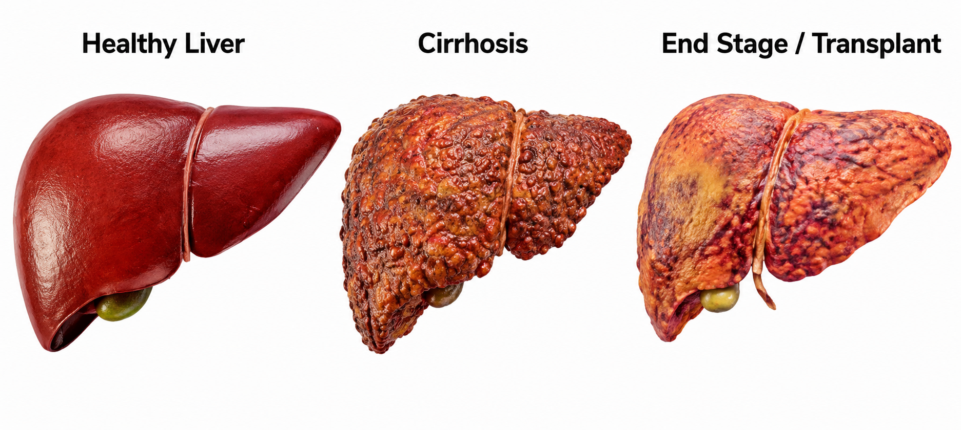
Introduction
Liver cirrhosis is a chronic liver disease in which healthy liver tissue is gradually replaced by scar tissue, reducing liver function. Predicting mortality in cirrhosis patients remains challenging due to class imbalance and complex clinical data.
What did we do?
This study predicts mortality outcomes of liver cirrhosis patients using multiple machine learning and deep learning models. A major challenge was the imbalance between censored and death cases, which often affects prediction performance. Different sampling techniques were applied to reduce class imbalance and identify the most reliable predictive model.
How does this improve healthcare?
Early mortality prediction helps clinicians identify high-risk patients and supports timely clinical intervention. Reliable prediction models can assist healthcare professionals in monitoring disease progression and making informed treatment decisions. This study demonstrates improved prediction performance, which may contribute to better patient management and clinical decision-making.

Slide 3
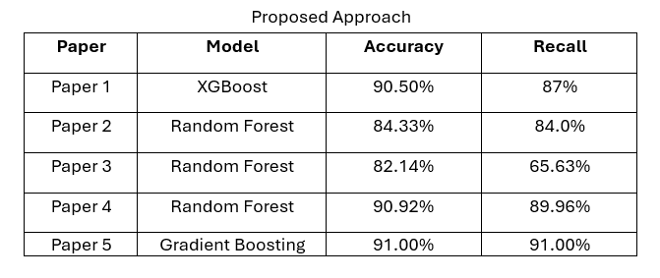
Limitation of Literature Review
Machine learning models used for liver cirrhosis prediction in prior studies published [1], [2], [3], [4], especially those using the Mayo Clinic primary biliary cirrhosis dataset, have shown promising prediction performance. Many studies published in well-known journals have highlighted the effectiveness of different machine learning models for predicting liver cirrhosis outcomes. However, these studies also reported several challenges, including class imbalance, limited external validation, and poor model interpretability, which reduce the reliability of prediction in real clinical settings [1], [2], [3], [4].
Ref: [4]
➜ Class imbalance affects mortality prediction performance.
➜ Reduces the model's ability to perform well on other datasets.
➜ Limited model interpretability for clinical use.

Slide 4
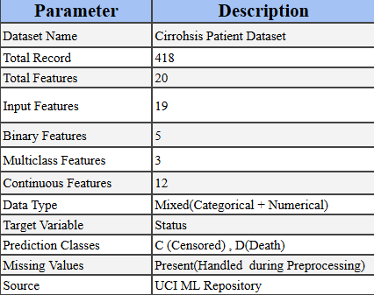
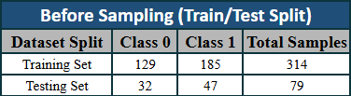
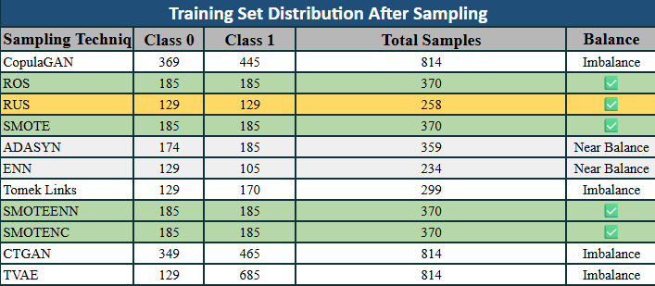
Overview of Datasets
The study uses the Mayo Clinic Primary Biliary Cirrhosis (PBC) dataset containing clinical records of liver cirrhosis patients. The dataset was divided into 80% training and 20% testing sets, and different sampling techniques were applied only to the training set to address class imbalance.
The dataset is imbalanced
The testing set remains unchanged for fair model evaluation.
SMOTENC achieved the best-balanced training distribution.

Slide 5
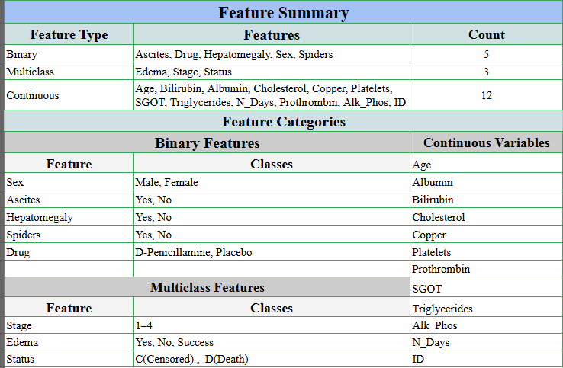
Feature Analysis
The dataset consists of binary, multiclass, and continuous clinical variables describing patient characteristics, laboratory measurements, and disease conditions. These categorized features provide meaningful clinical information for mortality prediction.
➜ The dataset contains 5 binary, 3 multiclass, and 12 continuous features.
➜ Clinical variables include demographic, laboratory, and disease-related information.
➜ These categorized features are used as input for model training and prediction.

Slide 6
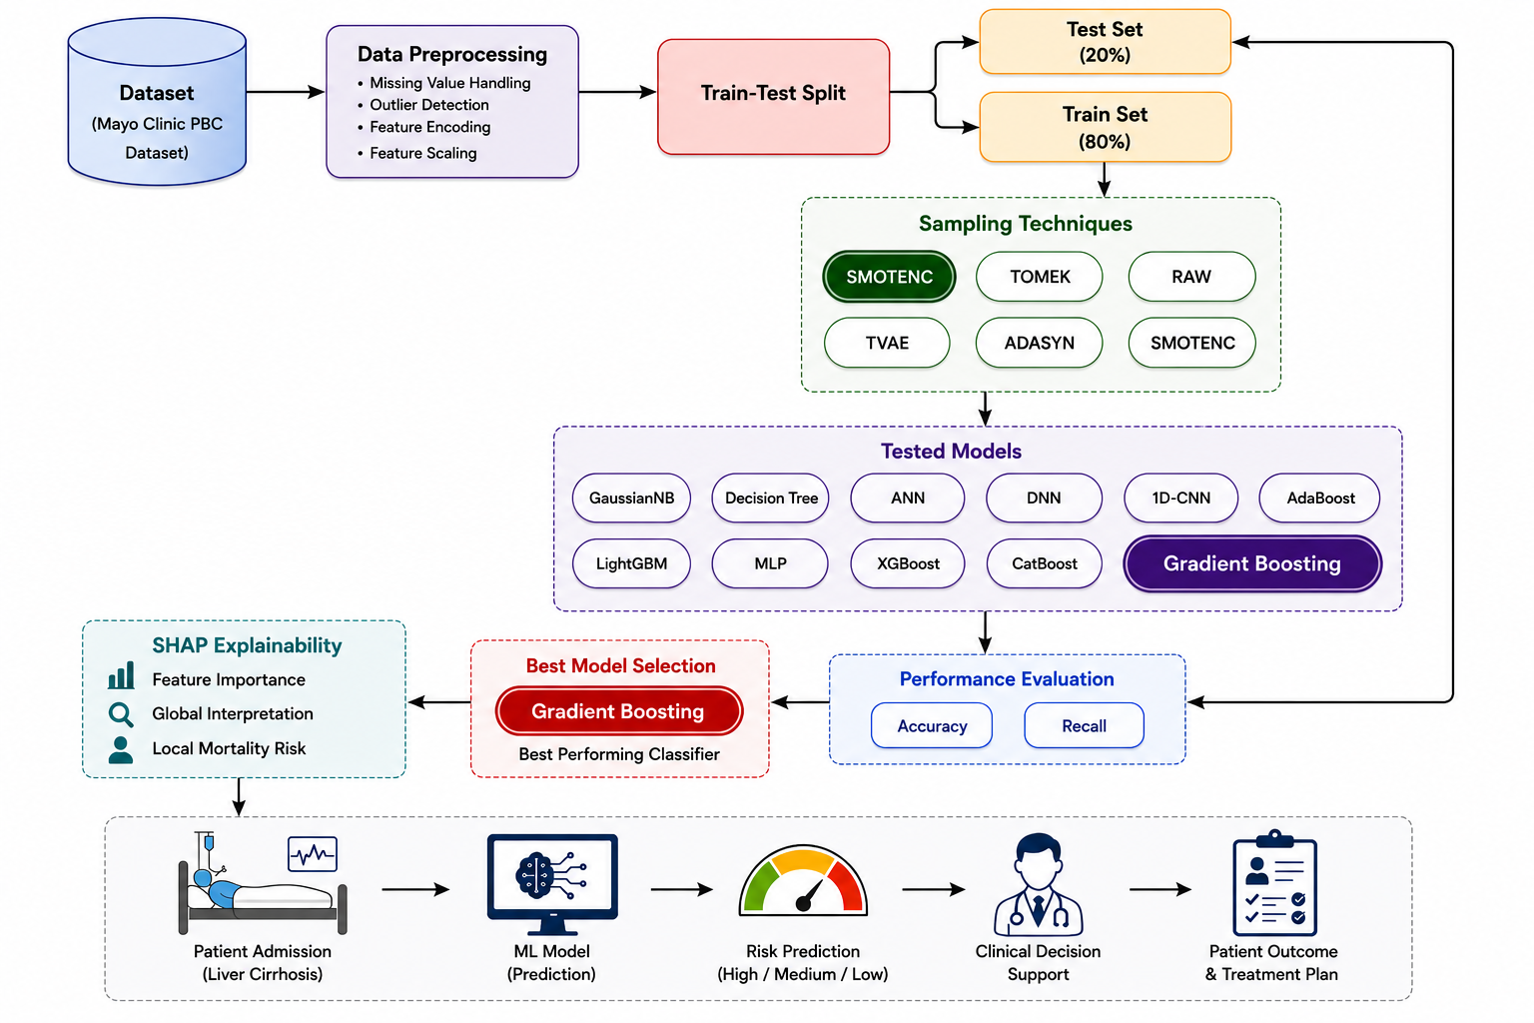
Workflow Overview
First, the Mayo Clinic PBC dataset is preprocessed by removing liver transplant cases, handling missing values, and applying label encoding. The dataset is then divided into 80% training and 20% testing sets for model development and evaluation.
Different sampling techniques (RAW, TOMEK, TVAE, ADASYN, and SMOTENC) are applied only to the training set to reduce class imbalance. Multiple machine learning models are trained and compared, where Gradient Boosting with SMOTENC achieved the best overall performance.
Finally, the selected model is evaluated using Accuracy and Recall, and SHAP Explainability is applied to identify important clinical features and interpret the model's predictions, making the results more transparent and clinically meaningful.

Slide 7
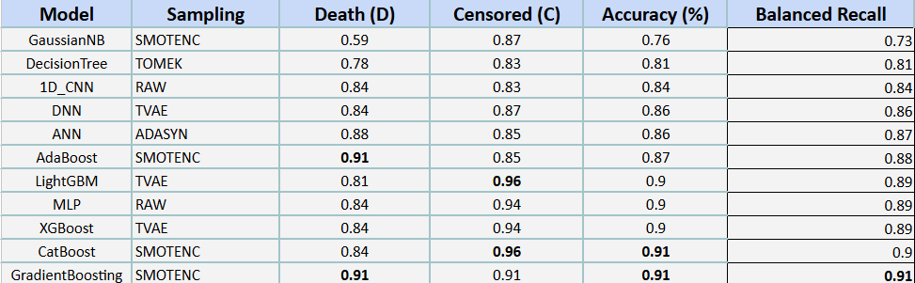
Result Analysis
TABLE I
CLASS-WISE PERFORMANCE OF DIFFERENT MACHINE LEARNING MODELS USING THEIR BEST-PERFORMING SAMPLING TECHNIQUES ON THE MAYO CLINIC PBC DATASET. THE BEST PERFORMANCE FOR EACH METRIC IS HIGHLIGHTED IN BOLD.
Table I presents the best-performing result for each machine learning model using its optimal sampling technique. Among all model–sampling combinations, Gradient Boosting with SMOTENC achieved the best overall performance, obtaining 91% Accuracy, 91% Death Recall, 91% Censored Recall, and 91% Balanced Recall.

Slide 8
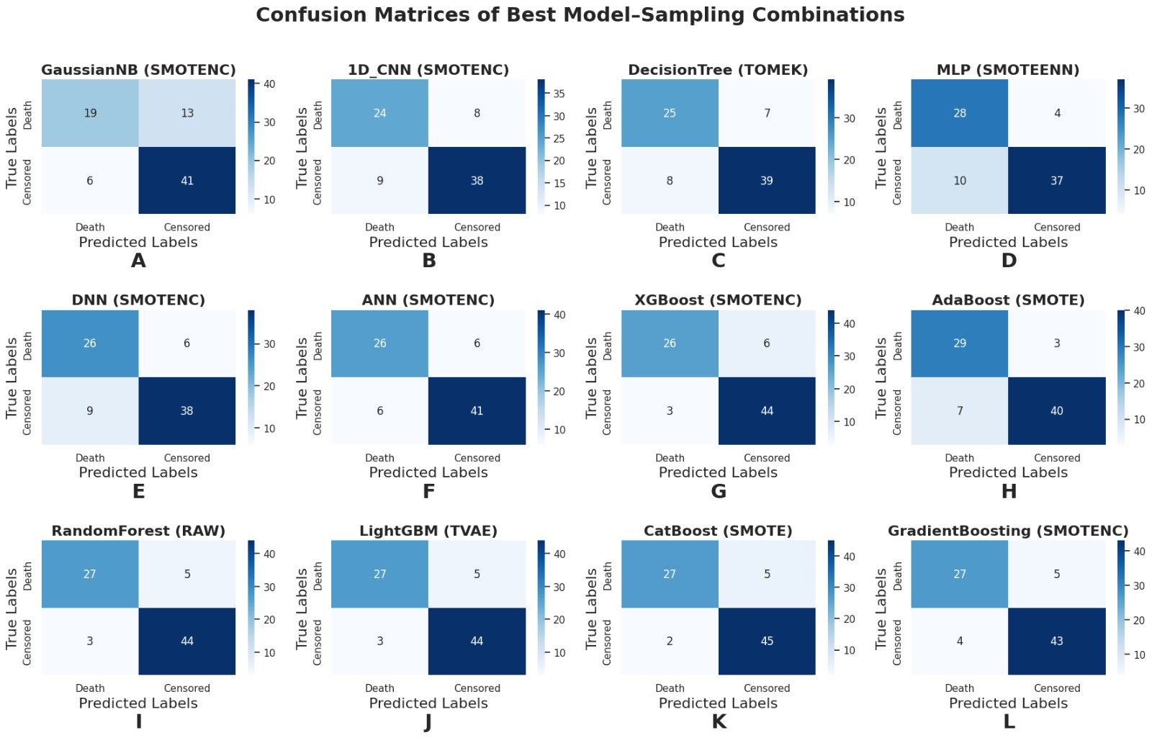
Result Analysis

Slide 9
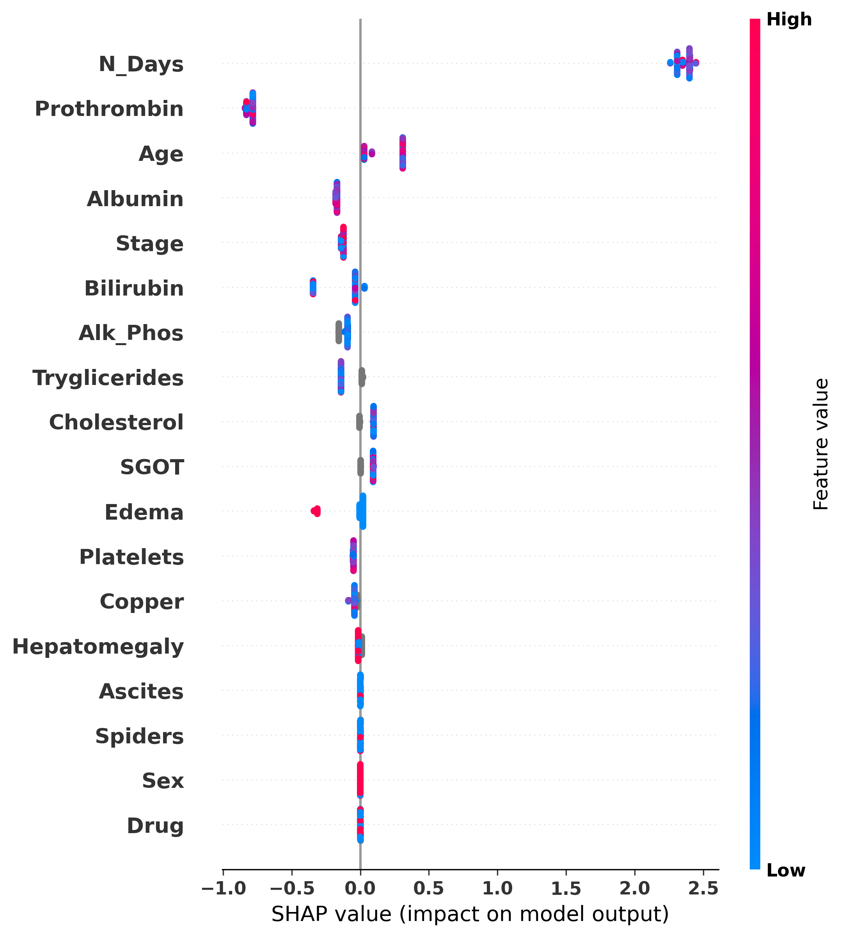
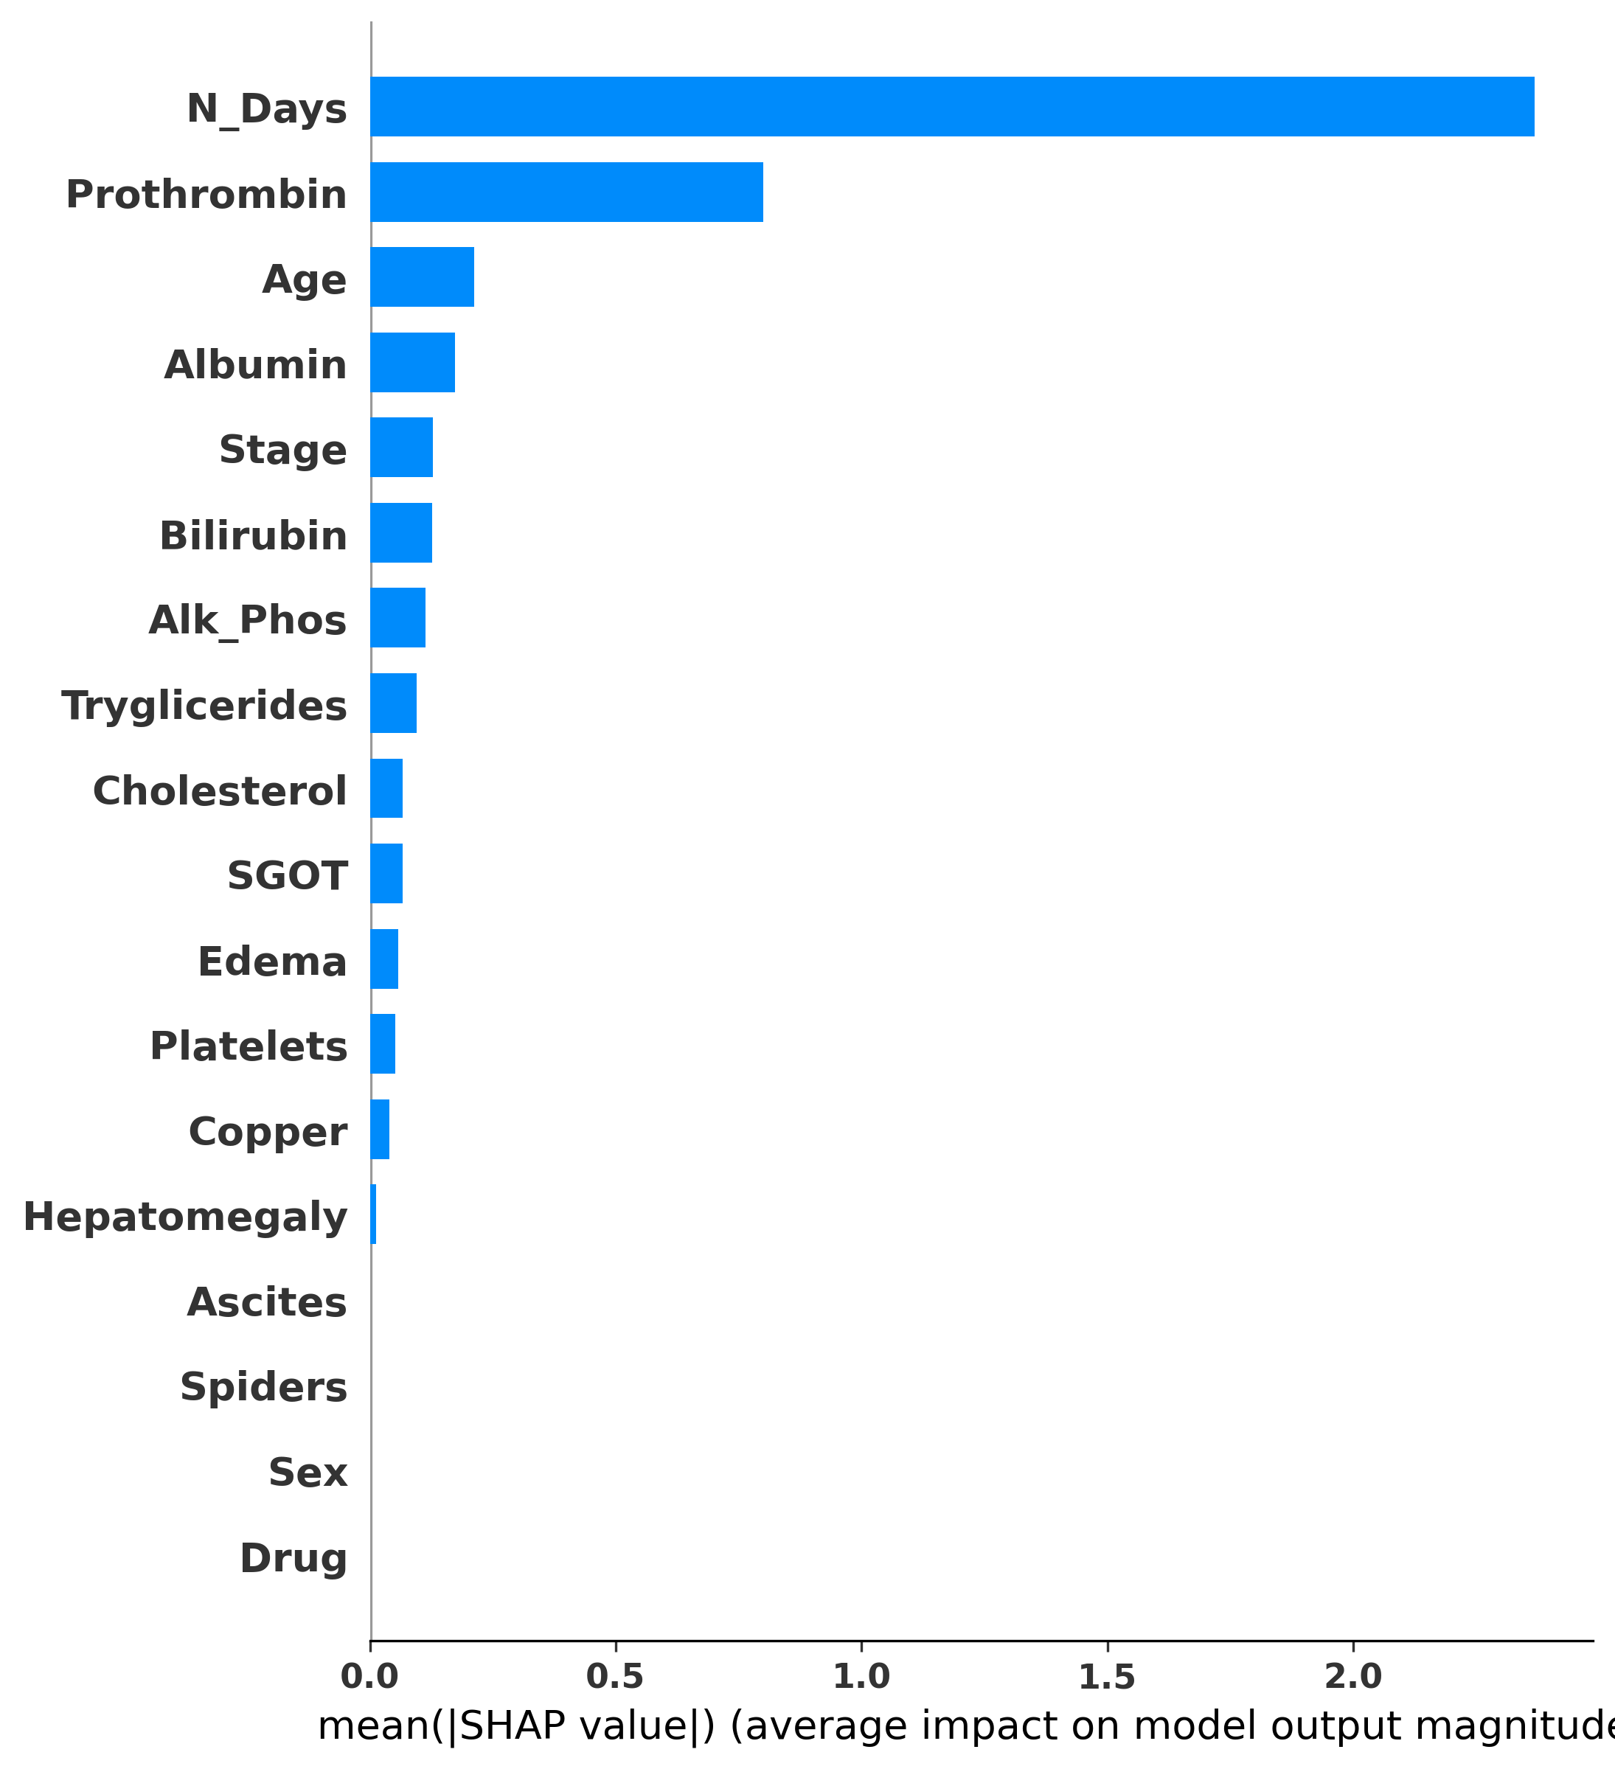
Model Explainability Using SHAP
Fig: SHAP Summary Plot
Fig: Feature Importance
➜ N_Days is the most influential feature.
➜ Prothrombin and Age strongly contribute.
➜ SHAP improves model interpretability.

Slide 10
Contributions
Future Plan
❖ Developed an explainable mortality prediction framework using machine learning.
❖ Addressed class imbalance using different sampling techniques.
❖ Compared multiple machine learning models for performance evaluation.
❖ Identified Gradient Boosting with SMOTENC as the best-performing approach.
❖ Enhanced model interpretability using SHAP analysis.
❖ Provided a framework for reliable liver cirrhosis mortality prediction.
❖ Validate the model on larger clinical datasets.
❖ Explore deep learning and hybrid models.
❖ Include multi-class mortality prediction.
❖ Improve model robustness and generalizability.
❖ Develop a clinical decision support system.

Slide 11
References
[1] A. Guo, N. R. Mazumder, D. P. Ladner, and R. E. Foraker, "Predicting mortality among patients with liver cirrhosis in electronic health records with machine learning," PLOS ONE, vol. 16, no. 8, 2021.
[2] C. Simsek, I. Tekin, H. Sahin, T. K. Sahin, B. Sivri, and Y. H. Balaban, "Artificial intelligence to predict overall survivals of patients with cirrhosis and outcomes of variceal bleeding," Hepatology Forum, vol. 2, no. 2, 2021.
[3] C. Yu, et al., "Automated Machine Learning in Predicting 30-Day Mortality in Patients with Non-Cholestatic Cirrhosis," Journal of Personalized Medicine, vol. 12, no. 11, 2022.
[4] C. Zhang, X. Wang, Y. Li, et al., "Prognostic Modeling for Liver Cirrhosis Mortality Prediction and Real-Time Health Monitoring from Electronic Health Data," Big Data, vol. 13, no. 2, 2025. doi: 10.1089/big.2024.0071.

